Slide 1
Iterator Design Pattern
The Iterator pattern allows clients to effectively loop over a collection of objects.
The iterator pattern allows defining various types of iterators that can be used to iterate a collection of objects sequentially without exposing the underlying form.
Iterators encapsulate the internal structure of how that particular iteration occurs. Ex: jQuery.fn.each()
@ShankaragoudaG

Slide 2
Iterator Design Pattern
Most languages have builtin iterators such as IEnumerable and IEnumerator; however, JavaScript only supports basic looping constructs such as for, for-in, while, etc.
The iterator pattern allows JavaScript developers to build other complex iterators which can be used to easily traverse collections that are stored in something complex such as graphs or trees.
Iterators follow the behavior where they call a next function and step through a set of values until they reach the end. Hence, an iterator has functions such as next, hasNext, currentItem, and each.

Slide 3
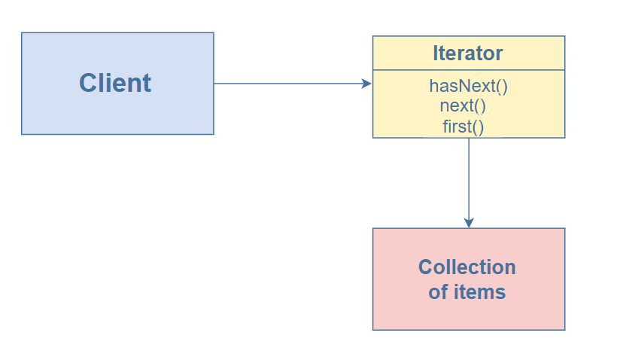
Diagram

Slide 4
Participants
Client:
references and invokes Iterator with collection of objects
Iterator :
implements iterator interface with methods first(), next(), etc
keeps track of current position when traversing collection
Items:
individual objects of the collection being traversed

Slide 5
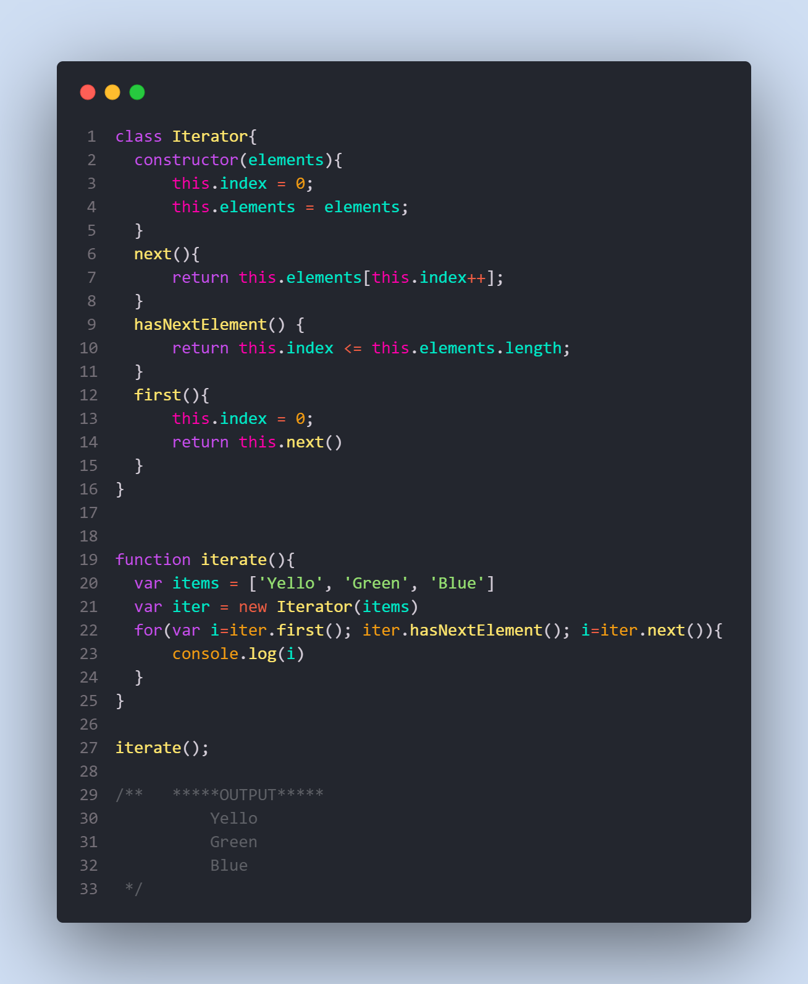
Example

Slide 6
Explanation
we created an Iterator class that initializes the following properties:
index: to keep track of the elements in the collection
elements: the data to traverse
next: to move to the next element in the collection
hasNextElement: to check if the next element exists in the collectionfirst: to move to the first element of the collection
Finally, to use this iterator, we implement the iterate function to traverse on all items.

Slide 7
Useful Resources
https://www.educative.io/collection/page/5429798910296064/5725579815944192/6071168076349440
https://www.patterns.dev/posts/classic-design-patterns/#iteratorpatternjquery
https://www.dofactory.com/javascript/design-patterns/iterator

